Slide 1

Entity-based self-supervised representation learning in Computer Vision and NLP
Sepehr Janghorbani
Department of Computer Science
Rutgers University
Notes:
Hi. First of all I wanted to thank everyone here for giving me the opportunity to present my work here today.
My name is Sepehr Janghorbani and the title of today’s talk is “Entity-based self-supervised representation learning of computer vision and NLP models”.

Slide 2
Outline
My Background
Selected Projects in Computer Vision
Scalable self-supervised entity-based Scene understanding
Multimodal self-supervised model evaluation framework
Other deep learning -based projects
Possible future directions
References
Notes:
So here’s how I plan to coordinate the talk:
First, I will give a bit of an overall background on myself and a brief overview of the projects I have been involved in.
Since the time for this talk is limited, in the next sections, I will talk in much more detail about only a handful of my more recent projects and then towards the end I’ll briefly mention the other works I have done as well as possible future directions .

Slide 3
Outline
My Background
Selected Projects in Computer Vision
Scalable self-supervised entity-based Scene understanding
Multimodal self-supervised model evaluation framework
Other deep learning -based projects
Possible future directions
References
Notes:
So here’s how I plan to coordinate the talk:
First, I will give a bit of an overall background on myself and a brief overview of the projects I have been involved in.
Since the time for this talk is limited, in the next sections, I will talk in much more detail about only a handful of my more recent projects and then towards the end I’ll briefly mention the other works I have done as well as possible future directions .

Slide 4




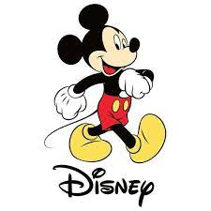
Background
Rutgers University
Design, implementation and evaluation of self-supervised deep learning models in Computer Vision and NLP.
Sharif University of Technology
Designed a machine learning model to identify causal factors of genetic diseases using Bayesian Inference.
Apple
Designed a deep learning-based model for automated natural language understanding to automatically summarize, connect and resolve Apple Care's customer support issues.
Dataminr
Prototyped a self-supervised image-based machine translation model.
Disney Research
Designed a deep neural model for real-time dialogue topic modelling using hierarchical self-attention.
Natural language understanding model for movie script understanding and automatic animation code generation.
Notes:
Right now, I’m a final year phd student at Rutgers university where the main theme of my research is design, implementation and evaluation of self-supervised deep learning models and applying them to Computer Vision, Natural language processing and multimodal domains. I’ll talk about what I exactly mean by this in more detail in the next sections btw.
I started my phd directly after doing my undergrad at Sharif University of Technology, and that was the first time I used machine learning to apply it to the medical domain. What I did there was to design a machine learning model that is able to identify causal factors of complex genetic diseases using DNA-based genomic data of patients from different ethnicities.
Aside from academia, I have also done research in different companies such as Apple, Disney Research and Dataminr as well. At apple, I was working at one of the research teams in Apple Care and the project I was leading there was to to design and prototype a self supervised machine learning model that can basically automatically summarize, connect and recommend resolutions for Apple Care's customer support issues as well as identify higher priority issues Apple care receives every day.
And I also worked at Disney Research as well for some time, where I lead two projects there during my internship. One for design and implementation of a topic understanding conversation system, where I designed heirerchical self-attention networks. And the other one was self-supervised natural language understanding system for automated code generatiaonof movie script understanding.
I also did a research internship in an AI emergency response company called Dataminer, where I prototyped a self-supervised image-based machine translation model that was used to translate languages that do not have paired text but use used the image space to translate them.

Slide 5
Outline
My Background
Selected Projects in Computer Vision
Scalable self-supervised entity-based scene understanding
Multimodal self-supervised model evaluation framework
Other deep learning -based projects
Possible future directions
References
Notes:
So here’s how I plan to coordinate the talk:
First, I will give a bit of an overall background on myself and a brief overview of the projects I have been involved in.
Since the time for this talk is limited, in the next sections, I will talk in much more detail about only a handful of my more recent projects and then towards the end I’ll briefly mention the other works I have done as well as possible future directions .

Slide 6
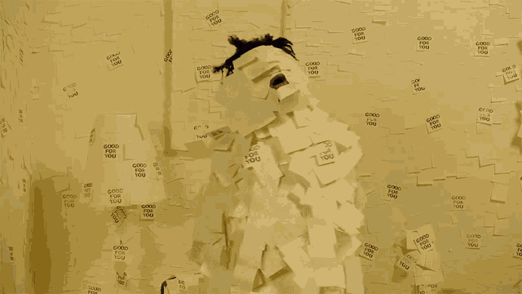
Self-supervised Learning - Motivation
Supervised learning has limitations
Requires significant amount of expensive labels.
In some domains, labels are totally nonexistent.
Ambiguous/Noisy labels.
Sometimes not generalizable to other tasks.
Counter-intuitive
Self-supervised learning is inspired by how human babies learn.
Notes:
So first let me just mention why do we even care about the concept of self-supervised learning? Although supervised models can be very useful, they also have serious limitations for certain applications.
For instance, supervised models often need large labeled datasets having hundreds of thousands of images for training, but getting these labels in many domains such as the medical domain can be very hard and expensive. For instance for disease classification or cell tracking we often might need very specialized experts to annotate our datasets, and that can be very expensive or even totally infeasible.
Another problem is that these labels themselves also can sometimes be ambiguous or noisy which introduces further human error into the process of training, or sometimes even labels for a specific task might not generalize well to other related tasks.
Another thing is these approaches are sometimes counter-intuitive compared to how humans or animals learn. So ideally we want a model that is able to learn from the structure of the data itself just like how humans babies learn rather than large annotated datasets.

Slide 7
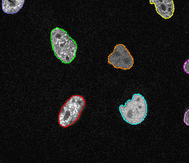
Self-supervised Models in computer vision
Contrastive models
Diffusion models
Entity-based models (Object-based models):
Objects are natural entities that represent the world’s structure.
Notes:
Now the question is what do I even mean by self-supervised learning? Self supervised learning over the years have refered to different concepts including contrastive learning-based models, diffusion-besd models etc. But there is also another set of methods called object-based models, which is the target of the first project I want to go through.
Object-based methods are a set of methods that try to explain the happenings inside of the scene in terms of objects and entities and their properties and interactions. For instance say we want to address the problem of cell tracking in the medical domain. Now we can think of different cells as different entities each one with different properties such as appearance, location, movement properties, interactions to other cells etc, and the goal of object-based model is to infer and learn all of these information from the structure of the data itself without any extra supervision.

Slide 8
Outline
My Background
Selected Projects in Computer Vision
Scalable self-supervised entity-based scene understanding
Multimodal self-supervised model evaluation framework
Other deep learning -based projects
Possible future directions
References

Slide 9
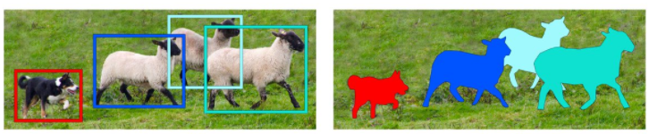
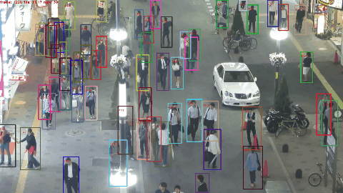
Object Detection and Tracking: A Fundamental Problem
Some of the most fundamental problems in scene representation learning:
Object detection
Object tracking
Object Segmentation
Object Detection Object Segmentation Object Tracking
Notes:
Before that, let me quickly define some basic terms that’s necessary for this part.
Object detection is the process of identifying the objects present in a given image, and put bounding boxes around them.
Object segmentation, is about finding more fine-grained borders indicating where exactly the objects are and what’s their shape, giving us segmentation masks.
And finally the object tracking problem involves working on videos, where we try to track the identified objects and their respective ids consistently over frames.

Slide 10
Object Tracking: Often solved with supervised approaches
Most of the methods were supervised until very recently:
MOHART: Multi-Object Tracking with Relational Reasoning (Fuchs et al. 2020)
Siam R-CNN: Visual Tracking by Re-Detection (Voigtlaender et al. 2020)
Real-Time Recurrent Regression Networks for Visual Tracking of Generic Objects (Gordon 2018)
Online Multi-Object Tracking with Dual Matching Attention Networks (Zhu et al. 2019)
FairMOT: Fairness of Detection and Re-Identification in Multiple Object Tracking (Zhang 2020)
ByteTrack: Multi-Object Tracking by Associating Every Detection Box (Zhang 2021)
Limited by the drawbacks of supervised approaches.
Notes:
As mentioned before, most of the State-of-art methods on object detection and tracking are supervised and they typically use either some form of region proposal networks or siamese networks, but these models can face serious limitations when we do not have enough labels in that domain.

Slide 11
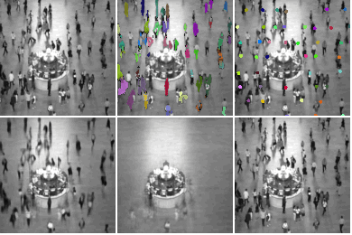
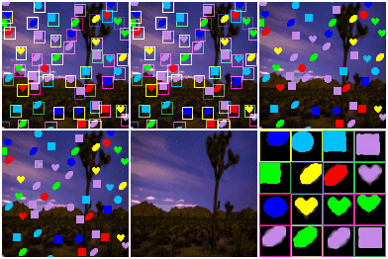
A Better Model: SCALOR
Goal: Propose a self-supervised scene-understanding model which can do object detection, segmentation, tracking and future prediction as part of a single model.
SCALOR: SCALable Sequential Object-Oriented Representation
Published at ICLR.
Notes:
So all of these problems that I mentioned so far motivated me to think about a new model that can do scene understanding with no need for annotated data and the model I came up with is called SCALOR, which stands for “Scalable Sequential Object-Oriented Representation” and this paper was published at ICLR.
Before I go into the details, Let’s look at the video on the left here. These are a bunch of people walking in the grand central station in New York. So as you can see here by only using the video on the top left the model is able to learn object locations, their segmentation masks and track and predict their future trajectories as well. One thing to note here is that as you can see these are highly crowded scenes and this model can track up to 100 objects simultaneously in each frame.
The video on the right is the synthetic data I made myself to do experiments for model deign. The input video basically is this and as you can see the model learns to detect object bounding boxes, track them and infer segmentation masks. something that’s even more interesting here is that in this case the background is even moving and it able to disentangle foreground objects from the moving background as well.
This model is trained end2end without any form of supervision at all and the learning signal comes just from the input video sequence.

Slide 12
A Better Model: SCALOR
Each video is a set of images, each made up of a dynamic background and a number of moving objects in the foreground.
Input: a set of frame pixels (Observations)
Output: Foreground objects and their properties, background dynamics
Attributes of each foreground object
Notes:
We have a dataset containing a set of videos, each video consisting of a set of frames shown by X. Each video frame is made up of a set of moving objects in the foreground as well as a dynamic background. Our goal here is to use the observed frames X to infer the properties of entities in the frame represented by z. each frame is made up of a set of objects in the foreground with their properties such as object appearance, object location and object movement properties. and appearance of whatever is happening in the background. This is similar to “latent variable modelling” where an observation is explained by a set of underlying entities or latent variables. And we solve this problem using something called variational inference and variational auto-encoders.

Slide 13
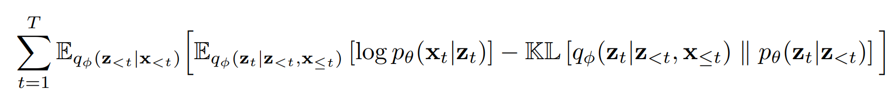
SCALOR Model: How does it learn?
Reconstruction loss (MSE) used as learning signal
Uses hard attention to attend to objects
Model is forced to learn object locations and appearances in order to reconstruct image
Notes:
In order to understand how this model works the question is how do we learn to track and segment objects without using labels and in other words where does the learning signal come from?
The intuition here is that we use some modification of an autoencoder-based architecture where the goal is to reconstruct the input video. But since we have specific design choices in the architecture of the model, the model can only reconstruct the original video correctly if and only if it detects, segments and tracks the moving objects properly. In other words, we are basically telling the model that there are say at max 100 objects in this scene now it is your job to find out which part of the scene you should attend to and where to put bounding boxes and what segmentation masks should you use in order to be able to reconstruct the original image properly and if you cannot solve those tasks then the original images are not reconstructed properly and so the reconstrucion loss goes up. so inorder to minimize the reconstruction loss and with some propper training tricks, it is forced to be able to detect, segment and track objects
This is basically our learning objective which is just the the Mean Squared error reconstruction loss plus some extra term which is useful for prediction quality of the model.
This equation is very famous in generative model literature and called the Evidence lower bound, or ELBO.

Slide 14
SCALOR Model: Overview
Foreground-Background Model
Foreground Model: “Discovery-Propagation” Model
Discovery Module: Discovers newly introduced objects.
Propagation Module : Using separate trackers, propagates each of the existing objects from previous time-step.
Background Module: Infers underlying properties for the scene background.
Rendering Module: Renders the reconstruction image by rendering the foreground objects and the background scene.
Notes:
Our model consists of several modules. It has a foreground module in charge of tracking foreground objects and a background module for inference and generation of the dynamic background.
Foreground module itself runs two steps for each frame:
Step 1 is called “Discovery” and discovers new objects that just entered the scene.
Step 2 is called “Propagation” and updates the location and appearance of already existing objects from the previous time-step.
The background and rendering module are also in charge of inferring background properties, and rendering the reconstructed image respectively.

Slide 15
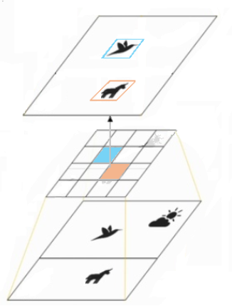

SCALOR Model: Discovery module
Feature map is divided into cells,
Each cell representing a potential object.
Object properties (appearance and location) are inferred in parallel.
These properties are further used to reconstruct the input image.
Notes:
Now, I will explain how each module works with an example. Let’s get to discovery module first.
Say that we have a scene *like this, where in the first frame there is a bird and a horse in the middle of the image and also sun and clouds in the background.
The way the model works is that, at first, features are extracted from the image using some Convolutional Neural Net. Then the feature map is divided into cells where each cell represents a potential object.
Next, for each of these cells, the set of property variables for appearance and location are sampled from normal distributions as well as a variable containing whether that cell contains an object.
For example here only two cells have an object inside. The ones corresponding to the horse and the bird.
These object property representataion will be used in the rendering phase in the future to reconstruct the whole frame. In particular, the appearance latent is used to reconstruct each object’s shape, color and mask. Then a Spatial Transformer is used alongside the position latent variable to render each object in its proper place in the reconstructed scene.
This is extremely fast because all these objects are discovered in parallel.

Slide 16
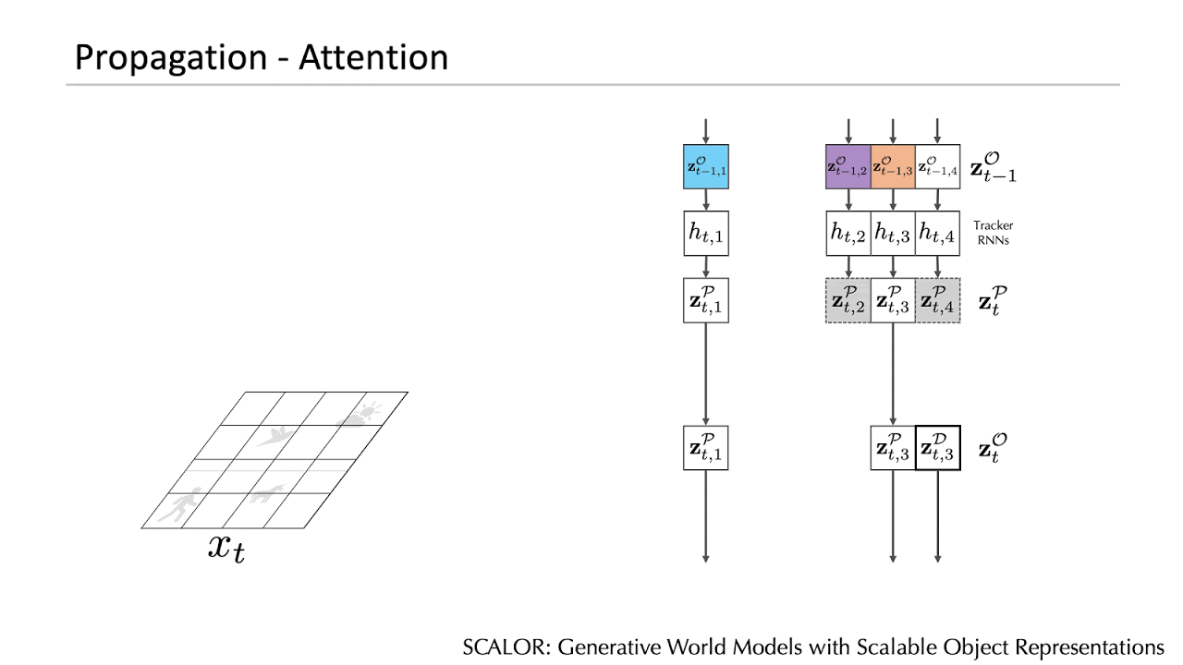
SCALOR Model: Propagation module
In the propagation phase, the model updates the position, appearance and presence of each of the existing objects based on the input image and information in its tracker.
We apply a fully parallelized attention mechanism for each object to attend to its own region of interest.
Notes:
Now let’s see what happens in the propagation step.
Back to our example, imagine the frame at time-step 2 is like this, where the bird and horse have moved a bit and a new object, that is this person, has entered the scene.
In the propagation phase, the goal is to find the updated location of the already existing objects , which in our case is the bird and the horse.
We don’t need to worry about the newly introduced person for now because we will discover him in the next discovery step.
We will use GRU based trackers to keep track of objects over time.
As you can see here, first the features of the image are extracted similar to what we did before, and then this information, as well as the tracker’s previous state and latents at previous timestep, are used to infer the current appearance and location of the object.

Slide 17
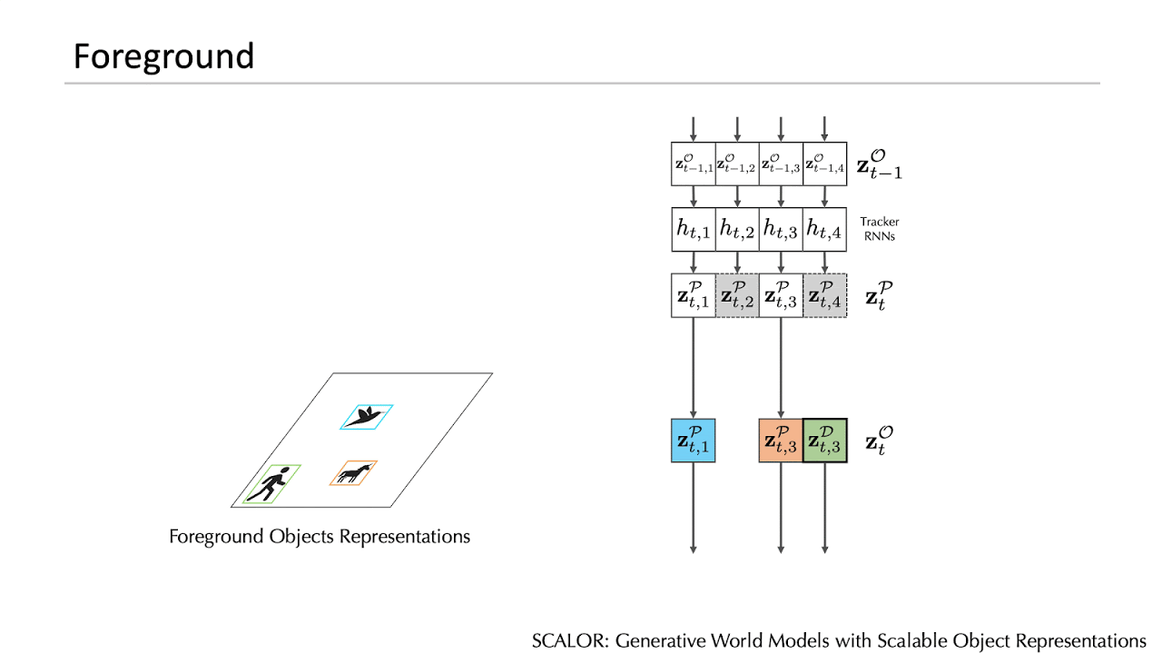
SCALOR Model: Background module
After inferring the foreground objects, the background module infers the background representation.
Background representation is inferred by incorporating the information from the input image and the foreground objects.
Notes:
Now that we have inferred representations for the foreground objects, let’s see how the the background is inferred. We introduce the background module as part of our model to model dynamic moving backgrounds, that is the sun and cloud in this example.
The background module infers the background latent by incorporating the information from the input image as well as the foreground objects masks. More specifically what we do is that, we render a mask of foreground objects and then sample the background latents conditioned on both the mask and the whole input image. This way the model tries to explain the foreground objects first, and then put whatever remains as the background.

Slide 18
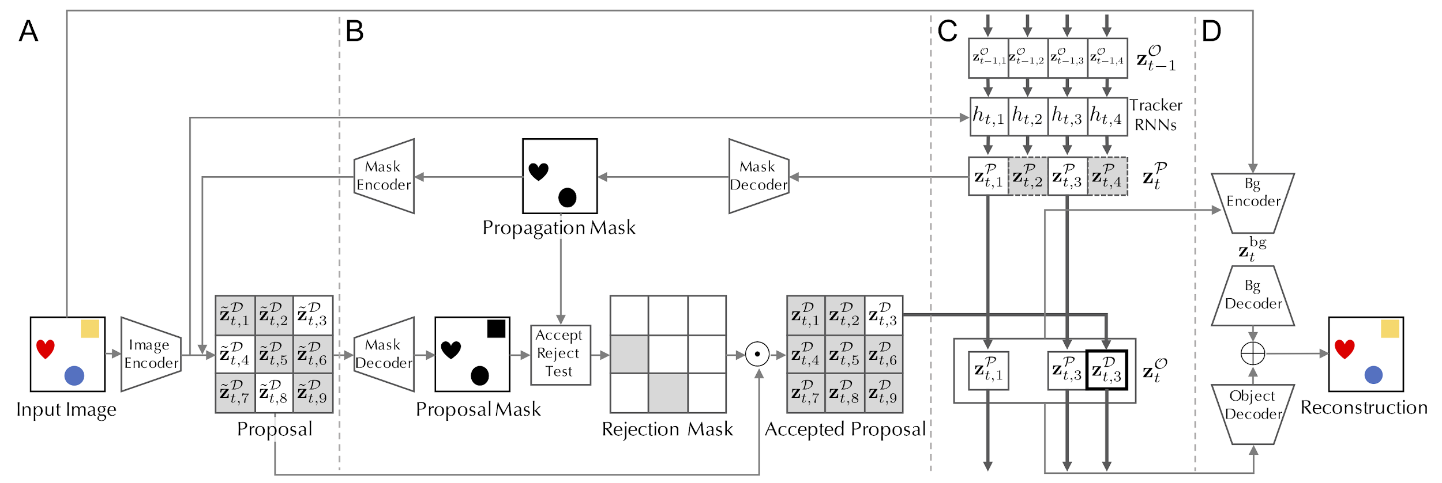
SCALOR: Entire Model
Discovery (Proposal) Discovery (Rejection) Propagation Background
and Rendering
Notes:
So let’s recap the entire model using a more compact visualization.
In this graph, discovery module is part (A) and (B) where (A) is the Proposal, and (B) is the rejection mechanism. (C) is the Propagation module, and (D) is the Background and Rendering Processes.
The proposal module (A) takes the input image and the propagation mask, and outputs the proposal latent variables for each of the potentially new objects.
Then in (B), from the proposal latent variables, the proposal mask is generated, and compared to the propagation mask to make an accept-reject decision. Only the accepted proposals are considered as valid discovered objects. In this slide, gray latents ,here*, means that there are no objects.
In Propagation, which is (C), the tracker RNNs decide what and where to propagate after looking at the input image as well as the previous latents. Again gray boxes, here*, represent what is not propagated.
Finally, in (D), the background module infers the background representation, and then the rendering process renders the whole image by combining the foreground and background representations according to the foreground mask assignments.

Slide 19
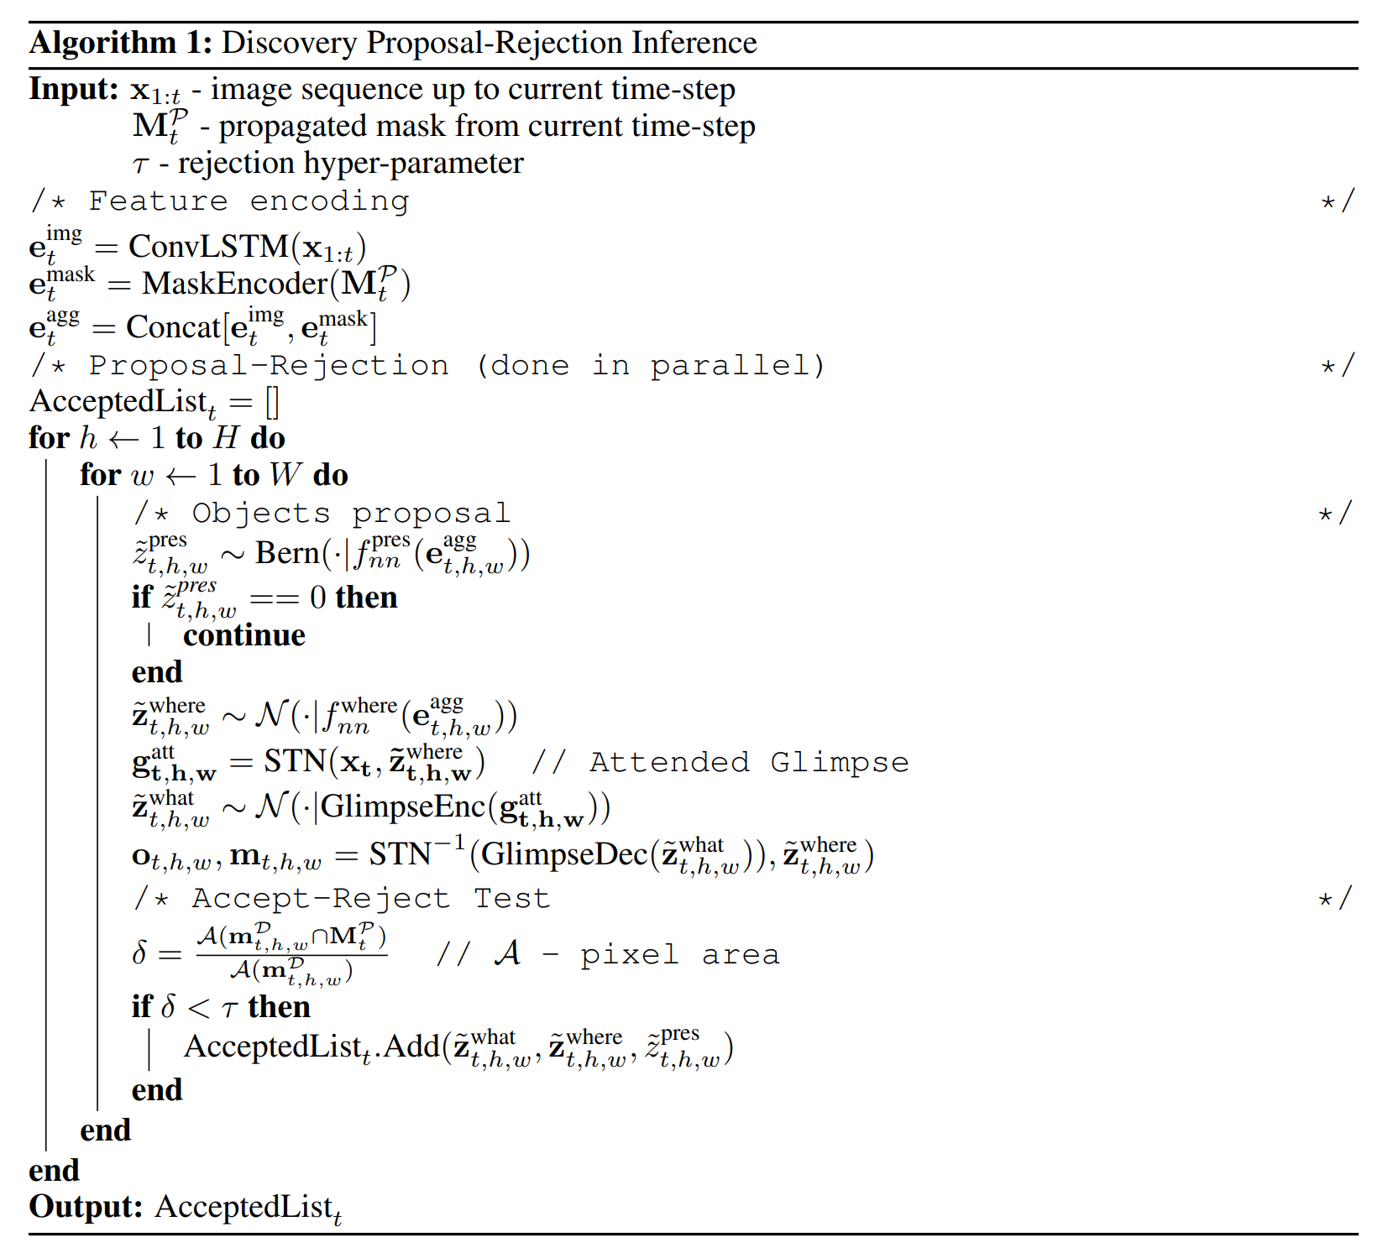
Notes:
I also made some detailed step-by step algorithms as well for each of the modules but because of the time constraint I will not go through them. We can discuss them later if there were any particular questions though.
So this is the Algorithm for discovery.

Slide 20
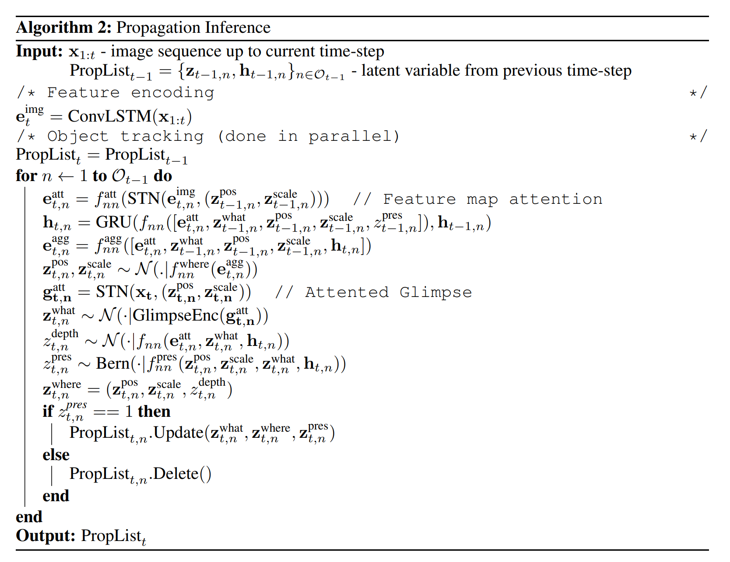
Notes:
Propagation.

Slide 21
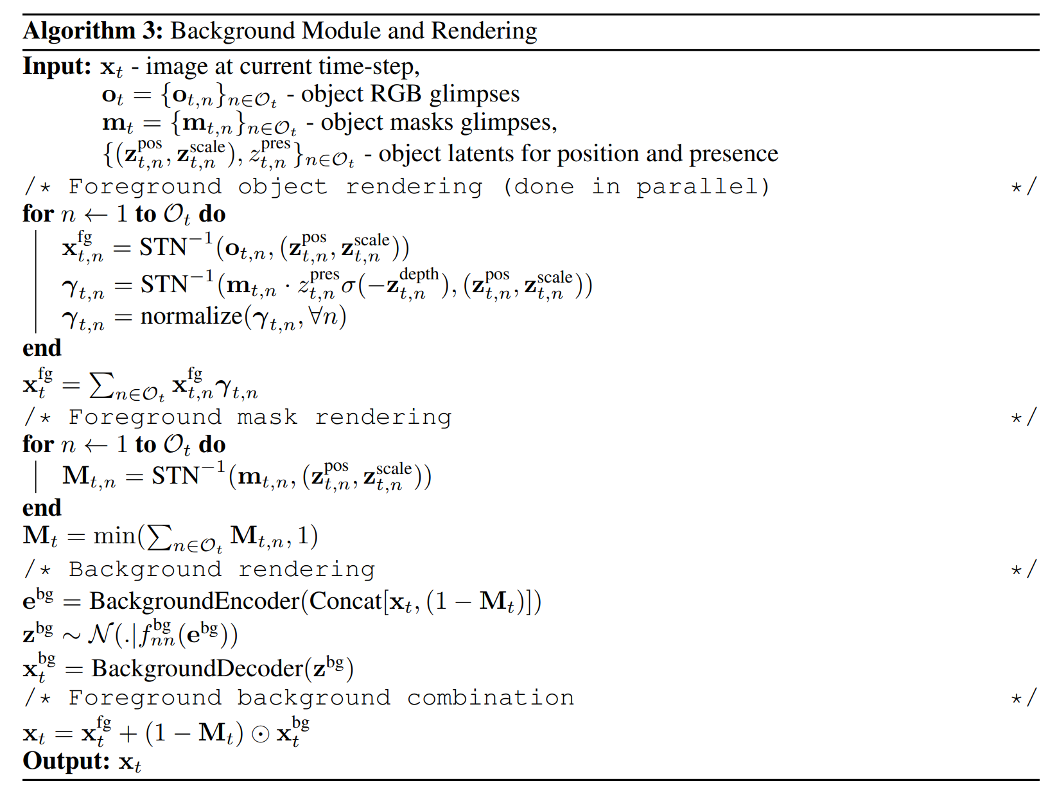
Notes:
And background module and the rendering process.

Slide 22
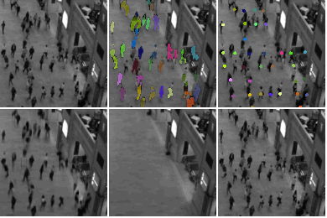
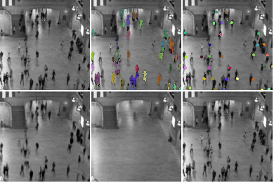
SCALOR Qualitative Results: Natural Scene
Input Sequence
Segmentation Mask
Inferred Center
Input Sequence
Segmentation Mask
Inferred Center
Frame Reconstruction
Background
Reconstruction
Inferred Trajectories
Frame Reconstruction
Background
Reconstruction
Inferred Trajectories
Notes:
The same experiment was also done on real-life natural videos of pedestrians walking.
Input sequences are these two on the top left * **, and these are the inferred segmentation masks, here * **.
The inferred center positions are also shown here * **, as well as the inferred trajectories * **.
As you can see, both the masks and trajectories are reasonably consistent and trajectories do not deviate unnaturally.
The reconstructed image, here * and here **, also looks reasonably accurate.
And our model is the first of this kind to scale such techniques into real-world complex datasets.

Slide 23
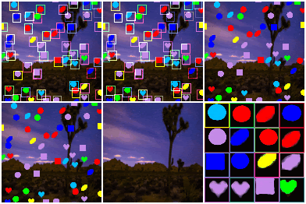
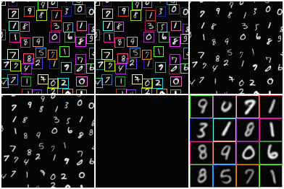
SCALOR Qualitative Results: Synthetic Toy Dataset
Tested on up to 100 objects but can handle even more dense scenes.
Input Sequence
Discovery
Propagation
Input Sequence
Discovery
Propagation
Frame Reconstruction
Background
Reconstruction
Object Reconstruction
Frame Reconstruction
Object Reconstruction
Notes:
We tested our model both on a set of synthetic toy datasets, like the ones here , as well as on real CCTV camera footage of crowds, which we will see in the next slide.
Look at the video on the left *. In the top left, here*, we see the input sequence as well as the inferred bounding boxes. Different colors here show ids for different inferred objects. See how tight and precise they are. Also notice that even after overlapping, the ids are not swapped.
The boxes obtained during discovery and propagation steps are shown here *.
And the actual reconstructed image and the inferred background are shown here*. As you can see, without any form of supervision, the model is able to disentangle the foreground and the background, and infer the dynamics of each accurately.
Some of the reconstructed objects are shown here*, which as you can see are pretty consistent and accurate.
The scene on the right shows the same thing but on a different dataset of moving mnist digits. Objects in this case are more fine-grained as MNIST digits have more details compared to simple shapes.
Again we can see that both the boxes and the shapes of the mnist digits are consistently inferred, even when they’re overlapping with each other.
The experiments here are conducted on significantly more crowded and more complex scenes compared to what was studied previously, which had about 3-4 objects at most.

Slide 24
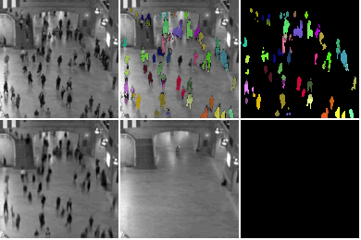
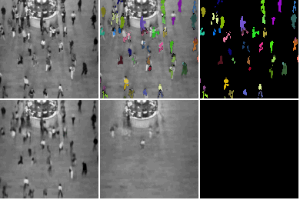
Qualitative results: Natural scene future prediction
Input Sequence
Segmentation Mask
Reconstructed Objects
Input Sequence
Segmentation Mask
Reconstructed Objects
Frame Reconstruction
Background
Reconstruction
Reconstructed Trajectories
Frame Reconstruction
Background
Reconstruction
Reconstructed Trajectories
Notes:
We test the same conditional generation ability on natural scene as well. When the margin is red the images are being generated. Again here the trajectories and segmentation masks are pretty consistent. For example see how the objects move in natural directions and how the masks keep evolving naturally.

Slide 25
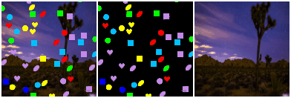
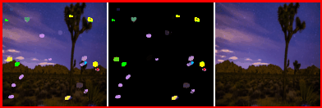
Qualitative Result: Generation
Future Prediction
(Conditional Generation)
Generated Sequence
Objects
Background
Generation
(From Scratch)
Notes:
In another set of experiments, we also tested the future-time prediction and generation ability of our model as well. The goal here is to test whether or not the model can predict the future in a realistic way, without having access to the video frames.
Here when the margin is red, the video is being generated and the prior network is used instead of the proposal network. In the top video, the model observes the first 5 frames, and then predicts the next 15 frames, using only the prior network without access to any other observations.
As you can see, the shapes and movements of objects are very consistent and do not deviate in an unrealistic way. This shows that the model’s prior network has learned the dynamics of the world properly. If that was not the case, the objects would move in unnatural trajectories, whigling or even jumping around.
Also if you look at the background, the frames and the dynamics inside them are generated very well too. For example we can see that the cloud continues its movement in the right direction by itself.
In the bottom scene, we test the ability of the model to generate from scratch without any prior observations. This means that even from time-step 0 we use the prior network, and we don’t show any prior frames at all.
Interestingly, here not only the movements are again pretty consistent, the objects also look similar to what the model has seen during its training phase, but just with different combination of shapes and colors.
This is an indication that the model has actually learned very meaningful and plausible representation of how the world works, since it can combine different shapes and colors to form new objects and then move them in whatever direction it wants, on a dynamic background which is also generated. As a result we can claim this is a propper world model.

Slide 26
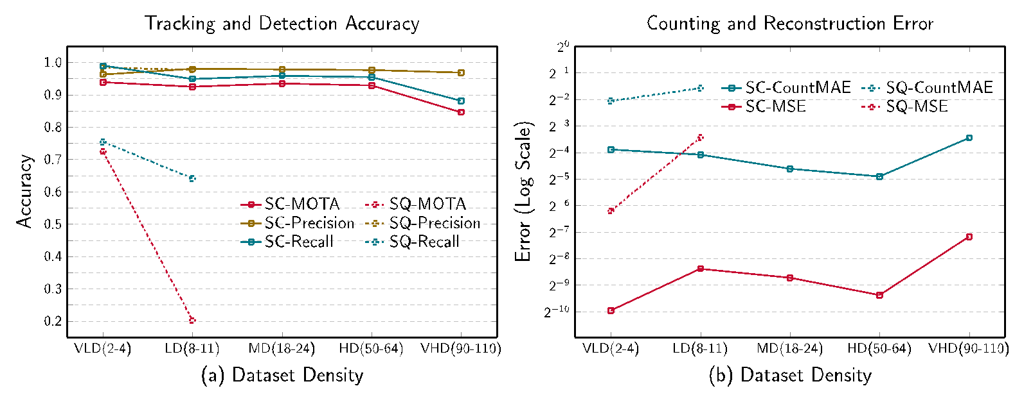
Quantitative Results: Tracking and Reconstruction Accuracy
Notes:
Now let’s get to quantitative results. We evaluated the model’s performance as well as its computational efficiency using different metrics.
The left figure, here *, compares standard multi object tracking metrics such as MOTA and precision and recall of our model with the baseline SQAIR. This comparison is done as the scene gets more and more crowded.
Our model outperforms the baseline significantly. For example in the low density case with about 8-10 objects, our accuracy is around 90-95%, while SQAIR barely reaches 20%. The dashed line here is the SQAIR and solid line is our model. The same happens with recall too.
Right figure compares reconstruction error and normalized counting error for both models. Counting error shows on average how many objects were missed or falsely detected. The lower it is, the better.
Again we can see that ours is much lower than SQAIR in both of the metrics. This is because of the more strong discovery model we used as well as the design choices.

Slide 27
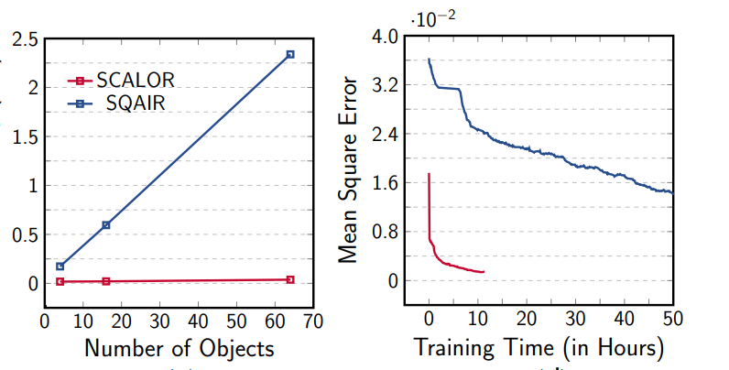
Quantitative Results: Training and Inference Speed
Notes:
Also from a computation standpoint, SCALOR outperforms the baseline. On the right figure, we see that SCALOR not only trains much faster but also achieves a lower training error. The red curve is SCALOR and blue is for the SQAIR baseline.
The left figure compares inference time at test time and while SQAIR’s time increases linearly, as the scenes gets more and crowded, SCALOR’s processing time remains roughly constant.

Slide 28
Outline
My Background
Selected Projects in Computer Vision
Scalable self-supervised entity-based scene understanding
Multimodal self-supervised model evaluation framework
Other deep learning -based projects
Possible future directions
References
Notes:
Now let’s get to another project I was involved in about providing a framework for evaluation of sevelra prominent self-supervised models.

Slide 29
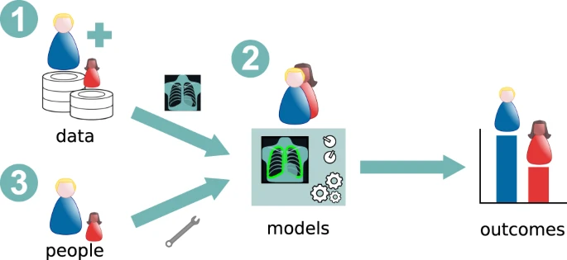
Stereotypical Bias Assessment in Multimodal self-supervised vision language models
Large pre-trained self-supervised vision–language models are getting prevalent
Shown to exhibit human-like stereotypical biases
harmful to society as well as corporations
Can open the door for expensive lawsuits
Notes:
Large pretrained Self-supervised models these days are getting very prevalent and show up in many applicaiont as a result it is very important to be aware of their weaknesses as well as their strengths. The power of these models mainly depends on their scale and the diversity and distributional properties of the dataset on they are trained. In many studies these models have shown be prone to exhibiting human-like stereotypical biases such as gender or race-related stereotypes . For instance, in a study published in Nature it was shown that the accuracy of diabetic retinopathy using medical images of accuracy of light-skinned patients was 73% vs. 60.5% for dark skinned patients mostly due to data imbalance making the model biased. This is very important because not only it is harmful to society on a humanitarian level but can be devastating for the companies developing these AI products since they open the door for lawsuits and financial losses.

Slide 30
Stereotypical Bias Assessment in Multimodal self-supervised vision language models
Most current studies focus on gender and racial biases
Other protected classes such as nationality, religion, sexual orientation and people with disabilities have received much less attention
This includes large portions of the population
40 million people in the US and about 1 billion people in the world suffer from some disability
Lack of proper benchmarking framework
Notes:
Although the bias in the gender and racial domain have been studied in some studies, there are still other notable groups such as religious minorities, national minorities, people with disabilities and LGBTQ people, that have received much less attention,and as I mentioned this can be really important because these subgroups consider a very large population globally and since they ahve legal status as protected groups any sort of perceived bias by vision-language algorithm can lead to potential lawsuits for companies. For instance, approximately 40 million people in the US and about 1 billion people in the world suffer from some sort of disability. One of the main obstacles for bias analysis of these relevant population groups has been the lack of standardized benchmark datasets that specifically enable an analysis of how they may be affected. In this work we will address that by providing a framework and also evaluating some models.

Slide 31
Stereotypical Bias Assessment in Multimodal self-supervised vision language models
Designed a visual and textual bias benchmark called MMBias
MMbias consisting of 3500 images & 350 phrases covering 14 minority subgroups.
Evaluated stereotypical bias in several prominent self-supervised multimodal VLP models
OpenAI CLIP (Radford et al., 2021)
ALBEF (Li et al., 2021)
ViLT (Kim et al., 2021)
Quantified bias present in these models, including both cross-modal and intra-modal bias.
Show meaningful bias
Introduce a novel post-processing debiasing method that preserves performance
Notes:
In this paper, we attempt to address this problem by gathering and releasing a visual and textual bias benchmark called MMBias, consisting of approximately 3,500 images and 350 phrases covering over 14 minority subgroups. Furthermore, we utilize the dataset to measure stereotypical bias in several prominent self-supervised multimodal VLP models that have attracted significant attention recently, namely OpenAI CLIP (Radford et al., 2021), ALBEF (Li et al., 2021), and ViLT (Kim et al., 2021). In our experiments, we quantify the bias present in these models, including both cross-modal and intra-modal bias. Our results confirm that these models harbor meaningful biases favoring certain groups. Finally, we introduce a novel debiasing method designed for such large pretrained models that can be applied as a postprocessing step to mitigate bias, and we show that this step does not adversely affect the performance in a substantial way.

Slide 32
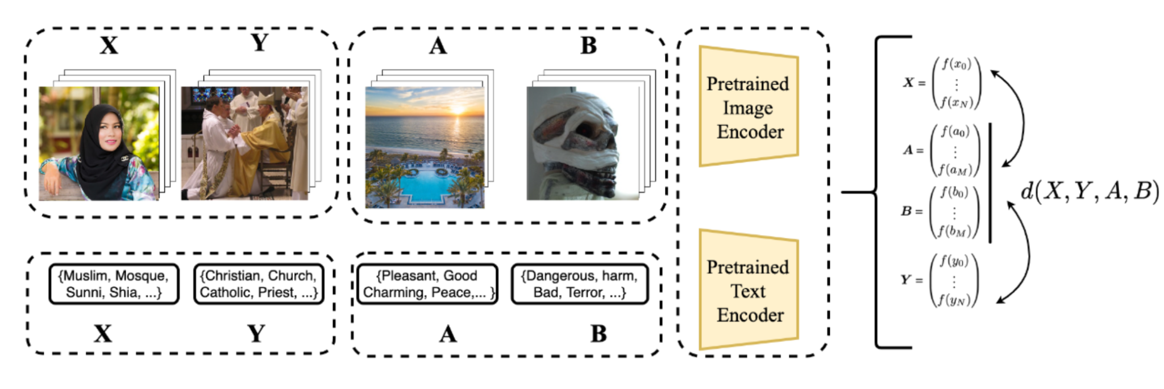
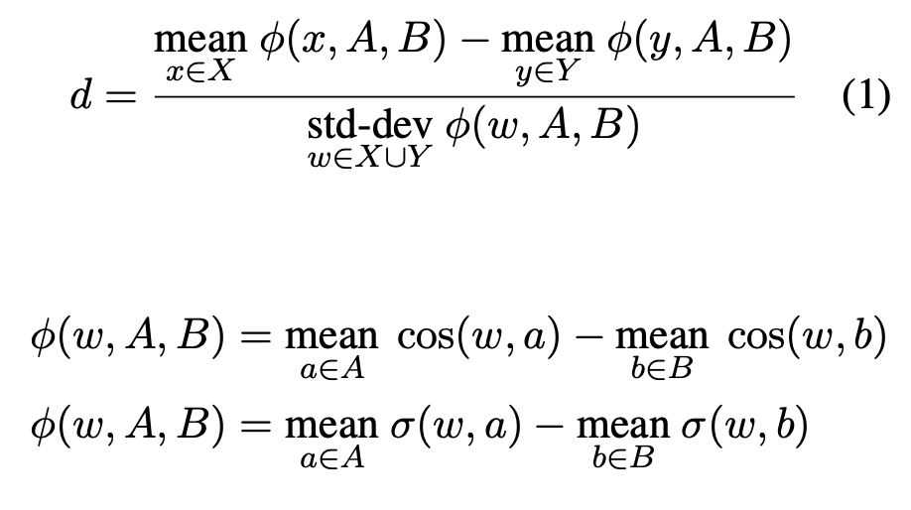
Stereotypical Bias Assessment in Multimodal self-supervised vision language models
Machine learning fairness: if predictions do not favor members of any relevant population group or discriminate against any other
Model should assign similar pleasant/unpleasantness scores across different groups
Implicit Association testing
Notes:
You can see the experimentation framework I have designed to evaluate these models. The idea comes from implicit association testing which is well known in the field of psychology for detecting implicit human bias for concepts to see how much they associate what with what. More specifically we test two sets of models CLIP and fusion based models where we have explicit embeddings of concepts and we score them using Caliskan metric.

Slide 33
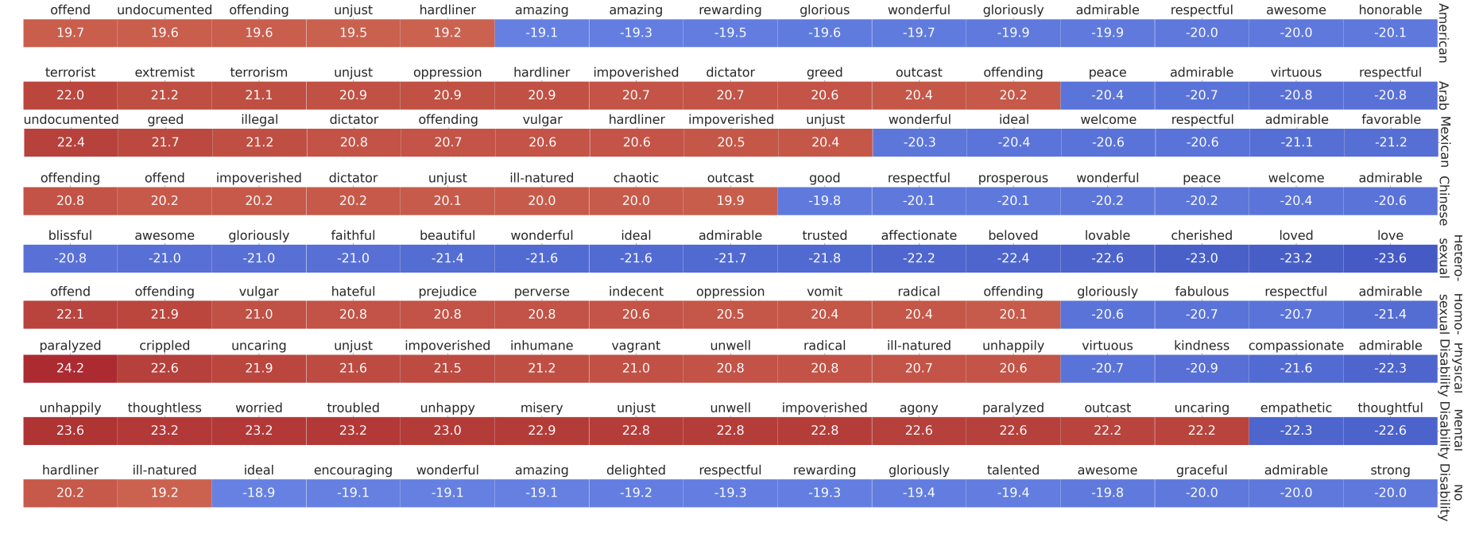
Stereotypical Bias Assessment in Multimodal self-supervised vision language models
Models associate different subgroups to positive/negative attributes disproportionately.
Notes:
For instance we can see that the models would associate negative sentimental concepts and words such as “vagrant” “inhumane” :unjust” :uncaring” much more to certain subgroups than others, here the red words show negative concepts while blue words show positive concepts and as you can see certain nationalities sexual minoriities and people with disabilities are associated with them much more based on IAT score.

Slide 34
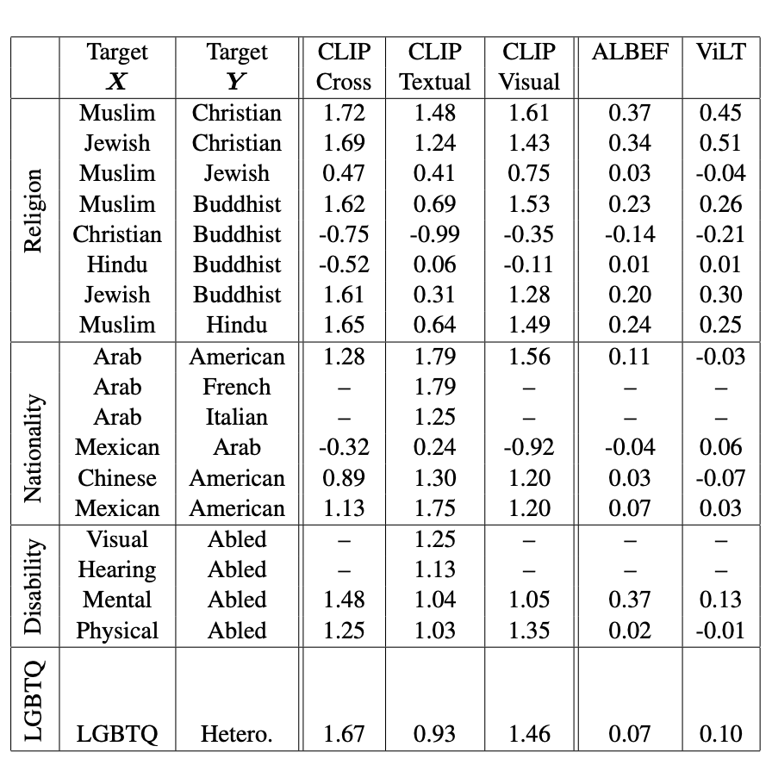
Stereotypical Bias Assessment in Multimodal self-supervised vision language models
Measurable stereotypical bias against certain subgroups
Notes:
This table is also quantification of the same phenomenon which as you can see certain groups are viewed more negatively by the model compared to others.

Slide 35
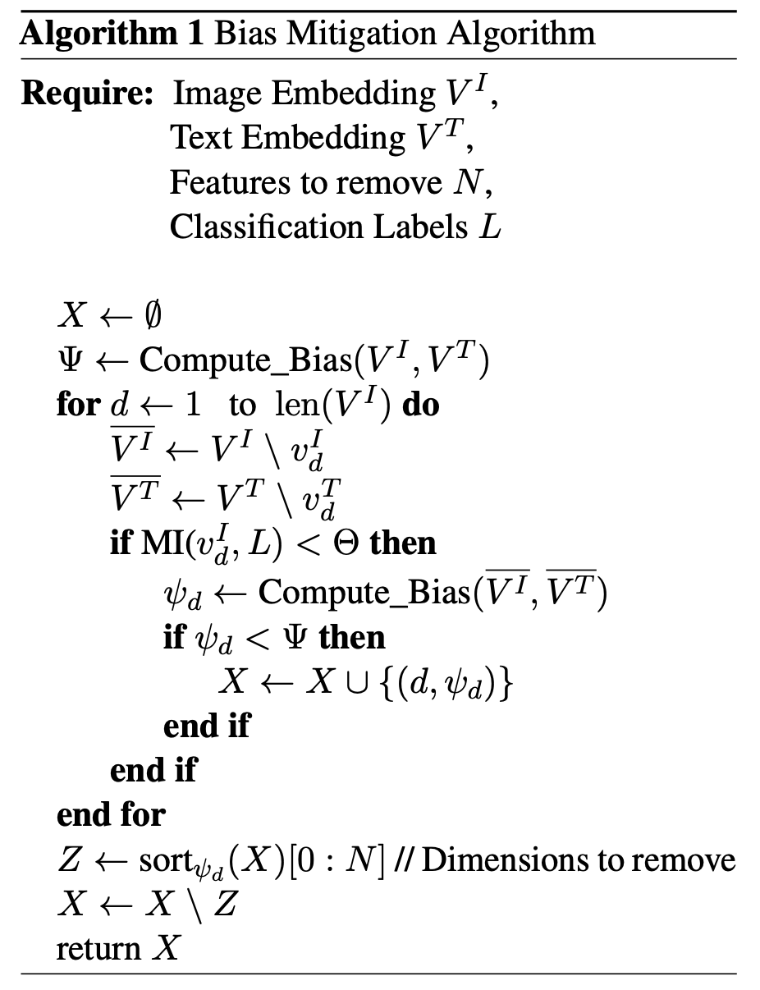
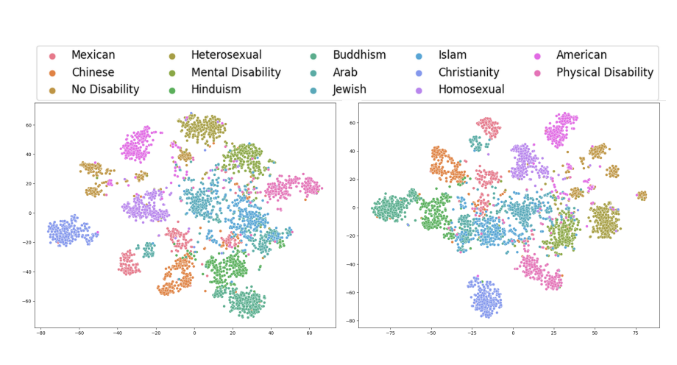
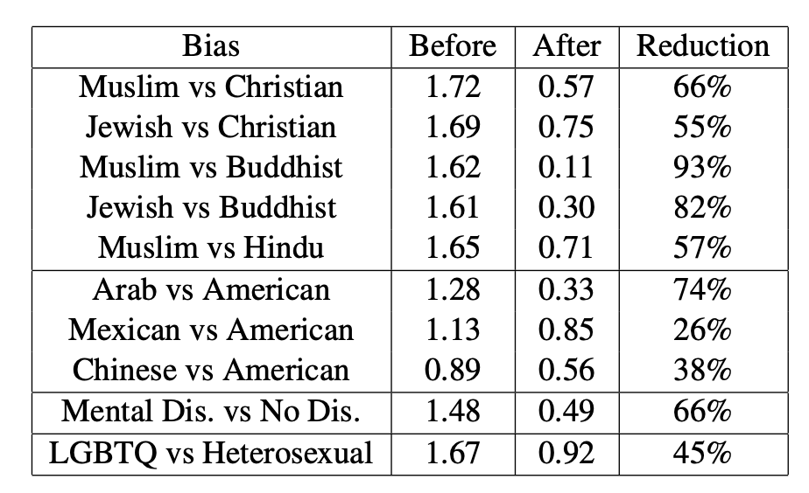
Stereotypical Bias Assessment in Multimodal self-supervised vision language models
Notes:
Then our idea was to come up with a method for debiaing these models . one issue here is that many of these models cannot be retrained due to computataion limitatiaons and so a post-processing approach can be very beneficial. We used caliskain metric as a direct metric to minimize with our debiasing algorithm and we omitted the redundant features having the most impact on the bias and this showed while the bias was reduced by up to 93% the accuracy only affected less than 1%

Slide 36
Outline
My Background
Selected Projects in Computer Vision
Scalable self-supervised entity-based scene understanding
Multimodal self-supervised model evaluation framework
Other deep learning -based projects
Possible future directions
References
Notes:
Let’s also talk briefly about the other projects I was involved in.

Slide 37
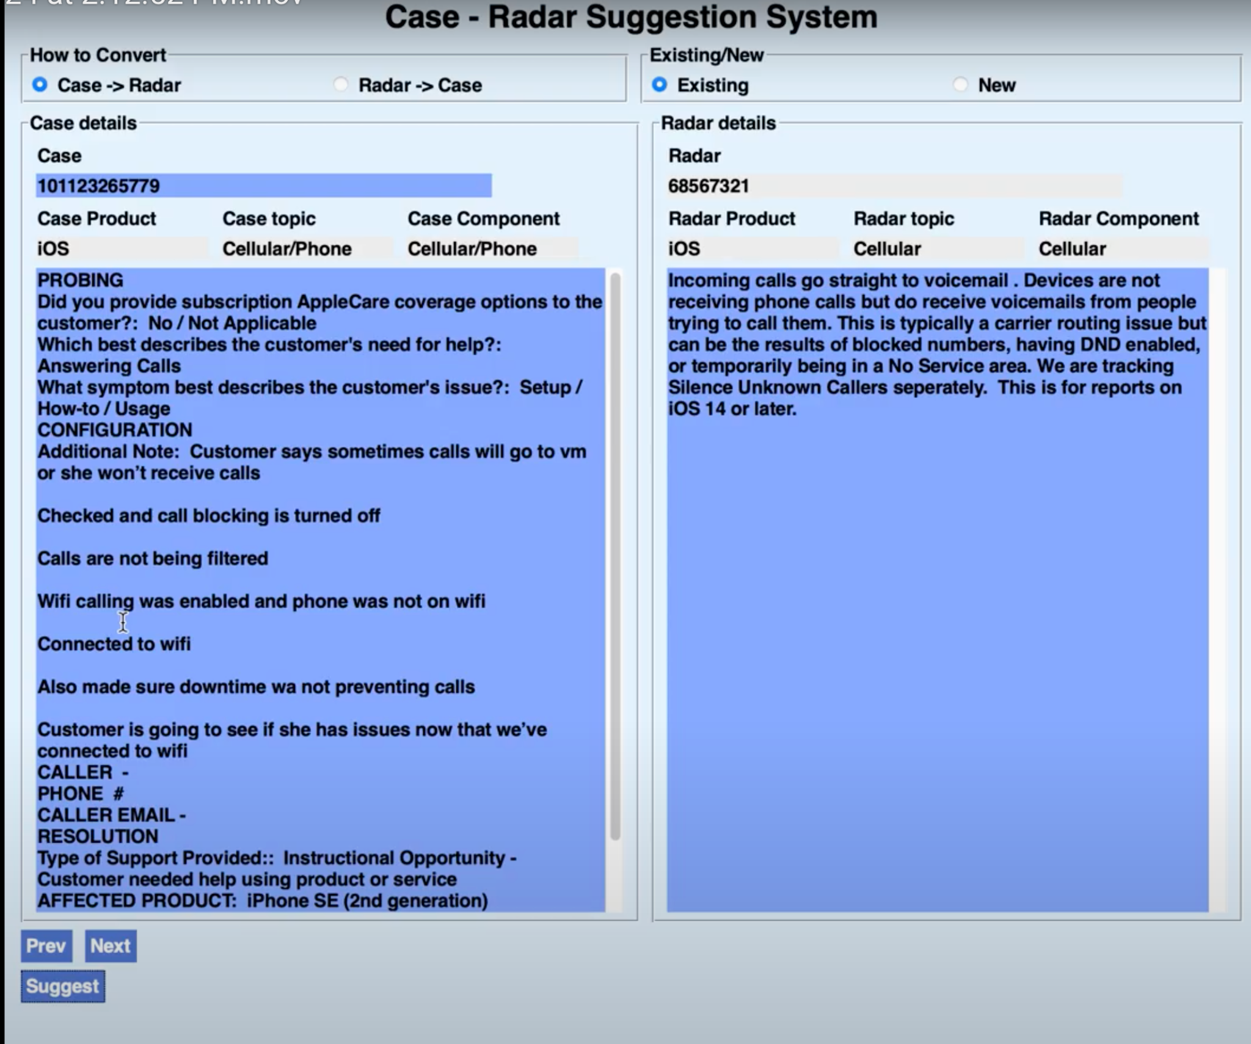
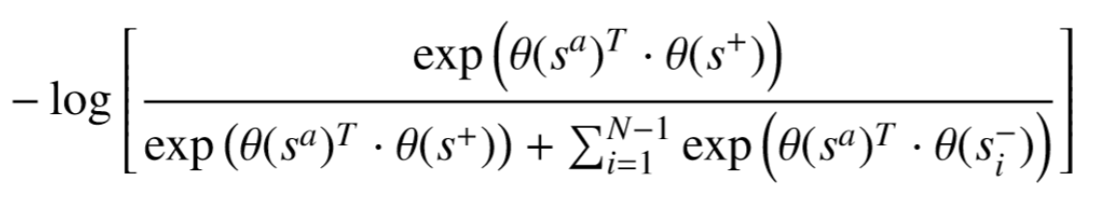
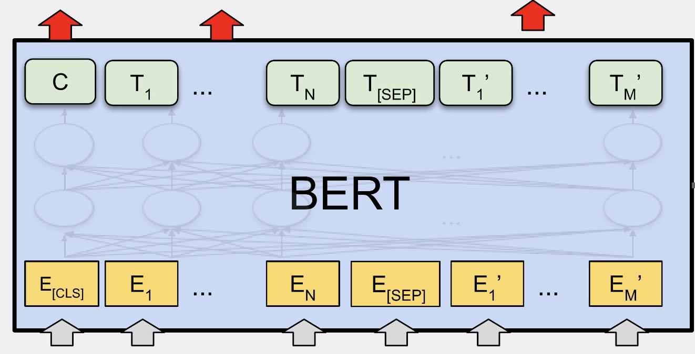
Self-supervised natural language understanding, text matching and issue resolution
Designed a transformer-based natural language understanding model to to automatically extract, retrieve, summarize, connect and resolve Apple Care's customer support issues.
Contrastive-based learning loss
Significantly enhancing issue resolution efficiency.
Notes:
The firs project I want to talk about is my work at Apple. At my internship at Apple I worked in one of the research teams in Apple Care’s business intelligence unit and basically the problem they had is they got hundreds of thousands of calls everyday from people having problems with their apple products. However a lot of these problems and issues were already known and resolved inside apple’s internal databases, so they wanted to have a system that basically understands longs paragraphs of problem desciritoin and matches that with the internal issues. Furthermore they also wanted to identify higher priority issues from the text. For this problem I used a transformer based model based on bert combined with contrastive learning to solve the text matching and recommendation problem. This is a demo of the system I developed.

Slide 38
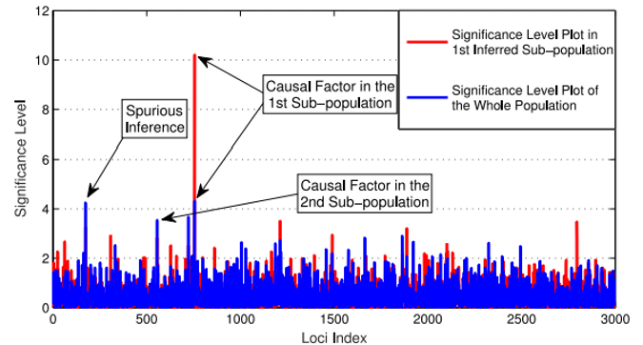
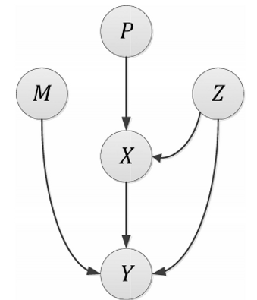
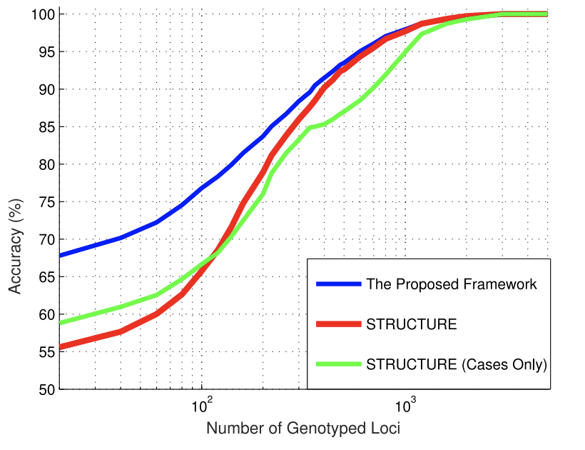
Genetic Disease causal discovery and association mapping in presence of hidden ethnic substructures
Designed a machine learning model for genetic causal discovery and disease association mapping of genetic data in the presence of hidden population structures.
Our model not only identifies the latent population structure for each data point but is also able to identify hidden disease causal factors.
Outperform SOTA methods with up to 15% accuracy.
Notes:
Another project I was involved in was designing a machine learning model to detect causal factors of genetic diseases. The problem I addressed was that given the genomic data of a set of individuals having a disease I wanted to have a model that first predicts the likelihood of a new person catching the disease. Secondly, the probability distribiuon of each combination of genes causing the disease and furthermore the other challenge was tha each person can have a different genetic background, and the disease typically manifests itself in different ethnicities differently designed a bayesian model to basically look at the genomic data of a population of individuals some of them having some sort of a with compelex diseases such as cancer, and basically the model would predict the chances of new patiets getting same disease. Also our model discovered the likelihood of combination genes causing the disease as well as how the disease is actually caused in different genetic populations, and by that I mean for instance different genes can cause different diseases in different populations. I used a Bayesian method bayes on Markov Chain monte Carlo to estimate the hidden variable’s distributions and infer the latent variables.

Slide 39




Semantic Understanding of movie scripts and automatic animation code generation
Natural language description of virtual reality animation world
What objects are in the world.
What properties these objects have
How these smart can interact with each other
How these interactions change the emotional state of virtual agents
Goal: Design a model model that gets natural language description of the virtual world and all its objects, semantically understands it and generates the planning code needed for the animation.
Notes:
In another project which was about ‘’Semantic understanding of movie scripts and automatic animation code generation ’’, I focused on applying some similar representation learning ideas to NLP.
The problem here is that we want to have an automated system that creates animations from natural language description of virtual reality worlds. More specifically, we have some intelligent virtual agent which posseses some sort of human-like personality.
Then we are also given a textual description of the personality of the agent in the form of natural language, as well as a description of the world it lives in with all the objects present there and how it can interact with each one, and how these objects affect and change the emotional state of the agent.
Then the goal would be to have some framework that gets this language description, which is written by a set of creative authors, semantically understands it and extracts and generate some interpretable and universal representation for that agent.
In fact, we want this representation to be so precise and interpretable that it can be directly used as a domain code in a planner, and as I will show we can even run the planner without problems. This will become more clear when I show an actual demo of this framework in the next slides, but before that let me mention some of challenge we had.
The input language we used was very custom since it was written by a team of creative artistic writers.
The amount of data was very scarce, maybe like a few pages only so using data-hungry deep models was not an option here. As a result I had to combine deep learning with more traditional linguistic approaches since they work better with less data.
Also the model had to tackle ambiguities in the text, and provide suggestions for missing aspects of the characters.

Slide 40
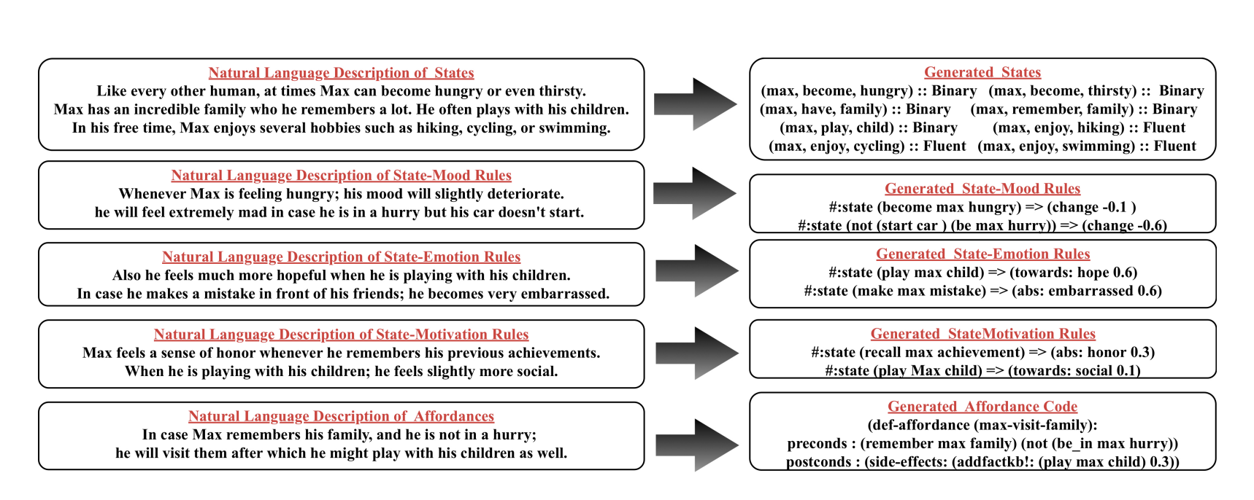
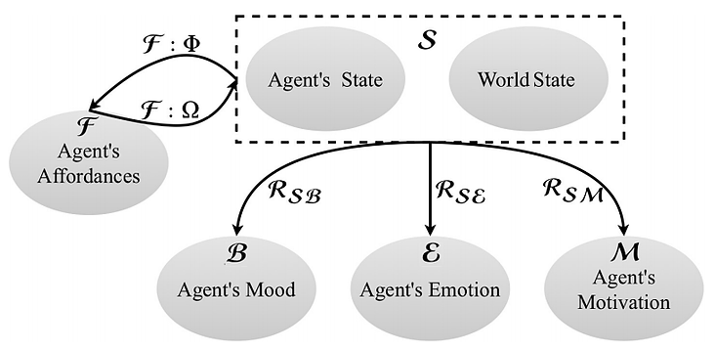
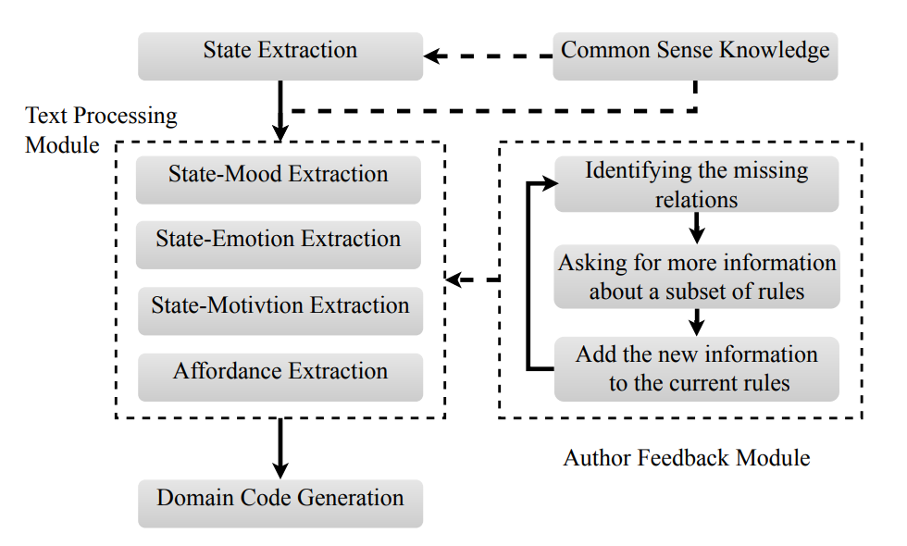
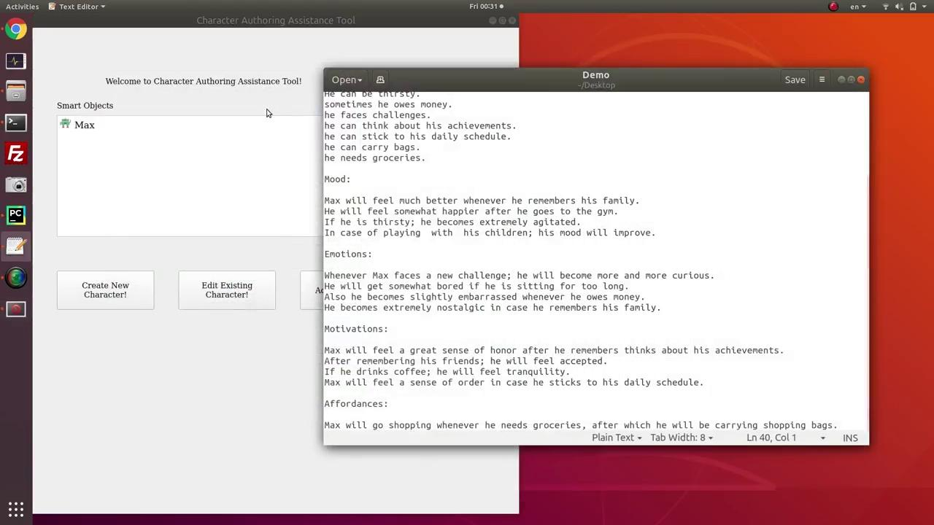
Semantic Understanding of movie scripts and automatic animation code generation
Published at “International Conference on Autonomous Agents and Multi-Agent Systems” (AAMAS).
Notes:
This work was published at AAMAS and was part of disney. Ok I have a demo which shows the working of this framework in action. Let’s look at it.
These two figures here also show the architecture of the model. So the agent has a set of emotions, moods, motivation and affordances and also some rules governing the relationship between these and the agent’s mental state.
So we want to extract these forms of knowledge from the raw input text using a pipeline like this.I won’t go into the details of this but this what we used.
Our framework not only provides universal representation for the character and its environment, but also automated the process of domain generation which used to be very resource demanding.
Previously a team of domain expert engineers had to constantly communicate with the team of authors to hand-engineer a custom planning domain for each of these agents separately, but with this model that is totally solved.
In addition our model is able to identify possible missing information, and iteratively make suggestions to authors.
Also it identifies inconsistent information in character description and suggests possible improvements.
Finally we also used a common-sense knowledge-base to suggest new possible aspects of the character and the story it comes in.
It can achieve reasonable accuracy on an annotated dataset authored by professional authors, and the generated representation can be used as code directly in a planner.

Slide 41
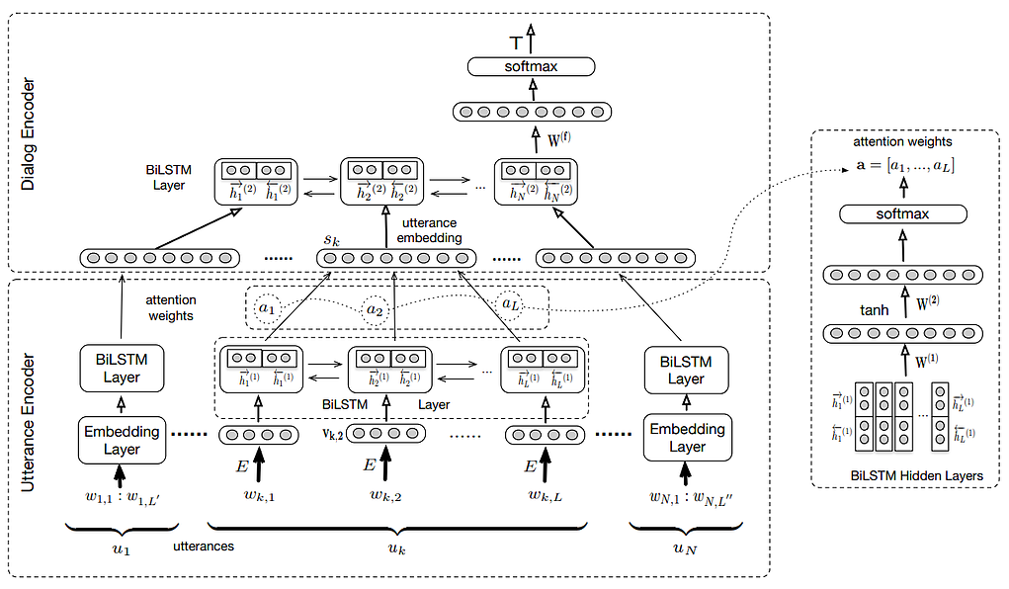
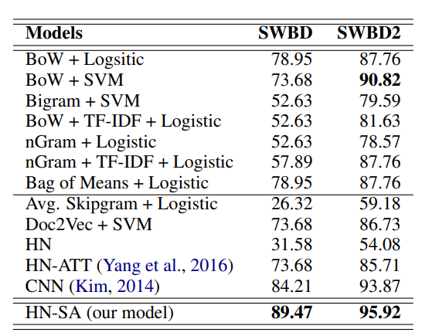
Topic Spotting in Dialogues Using Hierarchical Networks With Self-Attention
Using hierarchical attention to classify topics in an online dialogue
Published at NAACL.
Notes:
In another project I was involved in, which is called “Topic Spotting in dialogues using Hierarchical Networks with Self Attention”, we investigated the effect of using hierarchical attention to learn better hierarchical representations of sentences that will help classify topics in an online dialogue.
We used an architecture like this where attention first finds the sentence relevant to the topic and then focuses on relevant keywords in that sentence. This work is published in NAACL We tested the model on both online and offline version of the switchboard dataset which is the benchmark dataset for dialogue classification and this model outperformed all the baselines.

Slide 42
Outline
My Background
Selected Projects in Computer Vision
Scalable self-supervised entity-based scene understanding
Multimodal self-supervised model evaluation framework
Other deep learning -based projects
Possible future directions
References
Notes:
Let me also mention what future directions I’m looking into.

Slide 43
Possible Future Directions
Apply self-supervised techniques in other domains such as medical domain
Design universal self-supervised methods combining modalities (vision+audio+language)
combine different modalities in the medical domain to predict drug response in patients (genomic data + patient data + image data)
Apply self-supervised techniques for early disease identification
Notes:
Possible future directions

Slide 44
Outline
My Background
Selected Projects in Computer Vision
Scalable self-supervised entity-based scene understanding
Multimodal self-supervised model evaluation framework
Other deep learning -based projects
Possible future directions
References

Slide 45
References
Janghorbani et al. "Scalor: Generative world models with scalable object representations.” ICLR 2020.
Janghorbani et al. "Domain authoring assistant for intelligent virtual agents." AAMAS 2019.
Janghorbani et al. “MultiModal Bias: Introducing a Framework for Stereotypical Bias Assessment beyond Gender and Race in Vision Language Models” EACL 2023
Chitkara, Janghorbani et al. "Topic spotting using hierarchical networks with self attention." NAACL 2019.
Najafi, Janghorbani et al. “Statistical association mapping of population-structured genetic data” IEEE transactions on computational biology and bioinformatics
Radford et al. “Learning Transferable Visual Models From Natural Language Supervision” ICML 2021
Fuchs et al. “MOHART: Multi-object tracking with relational reasoning.” ICLR 2020.
Voigtlaender et al. "Siam R-CC: Visual tracking by re-detection." CVPR 2020.
Gordon et al. ”Real-Time Recurrent Regression Networks for Visual Tracking of Generic Objects.” IEEE Robotics and Automation Letters 2018.
Wang et al. “Fast Online Object Tracking and Segmentation: A Unifying Approach.” CVPR 2019.
Zhan et al. “A Simple Baseline for Multi-Object Tracking.” ArXiv 2020.

Slide 46

Notes:
Thank you. Are there any questions?

Slide 47

Notes:
Thank you.

Slide 48
Extras
Notes:
Thank you.

Slide 49
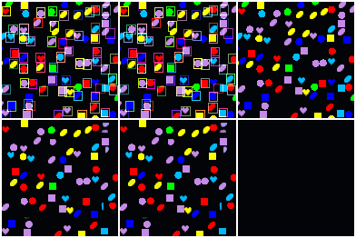
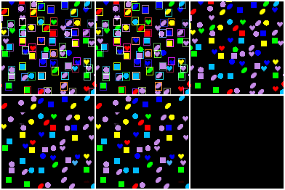
Qualitative Results: Very high Density
Scenes with 90-100 objects.
Input Sequence
Discovery
Propagation
Input Sequence
Discovery
Propagation
Frame Reconstruction
Discovery
Reconstruction
Propagation Reconstruction
Frame Reconstruction
Discovery
Reconstruction
Propagation Reconstruction
Notes:
Extra Slide

Slide 50
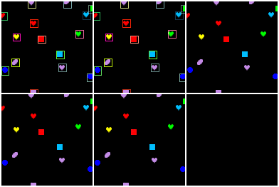
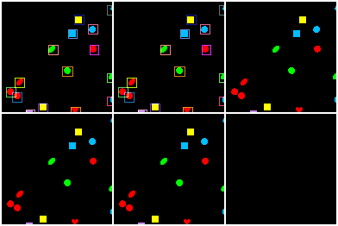
Qualitative Results: Frequent Dense Discovery
Evaluates the ability to discover many newly introduced objects several times.
For applications where only key-frames are available e.g. a sudden change in the observer’s viewpoint.
Input Sequence
Discovery
Propagation
Input Sequence
Discovery
Propagation
Frame Reconstruction
Discovery
Reconstruction
Propagation Reconstruction
Frame Reconstruction
Discovery
Reconstruction
Propagation Reconstruction
Notes:
Extra Slide

Slide 51
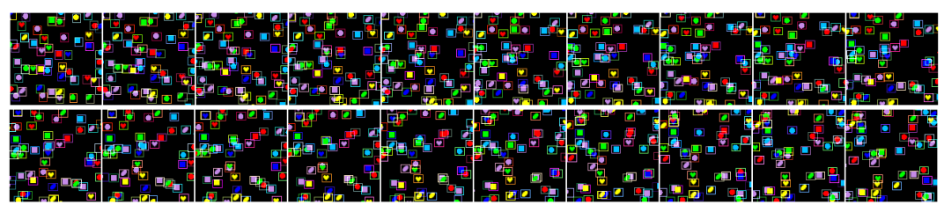

Qualitative Results: Ability to Generalize
Ability to generalize w.r.t: Longer sequences, unseen shapes, more objects.
Notes:
Just one more thing before we go to the next section. This slide shows the model’s ability to generalize.
The top row is showing that the model is able to generalize to longer sequences, where it saw sequences of length 10 during training and was tested on length 20.
The bottom images test the ability to generalize w.r.t unseen shapes or more crowded scenes. In the case of MNIST, it saw only digits from 1-5 but was tested on 6 to 9, and in case of shapes, it saw scenes containing 15 objects but was tested on scenes with 0 objects.
So we can see that the model can generalize pretty well too.

Slide 52


Generative Process
Notes:
Extra Slide

Slide 53


Inference Process and Learning Objective
Notes:
Extra Slide

